Slide 1
Computer Vision Homework 2
TA:
Gimmy: gimmy4268@gmail.com
Yi: whos2637@gmail.com
Office Hour: 15:00~17:00, Mon.
20:00~22:00, Tue.
At CSIE 9F Robotics Lab.

Slide 2
Notices (1/2)
Copying is strictly prohibited!! Penalty: instant zero for both sides!!
If the code can’t run ,you have one week to come to our Lab and show that your program can work, otherwise you will get zero!!
Due date => 2018/11/15 (Thursday) 23:59:59
No delay. If you submit homework after deadline, you will get 0.
Upload to => 140.116.154.1 -> Upload/Homework/HW2
User ID: cv2018 Password: cv2018
Format
Filename: Hw2_StudentID_Name_Version.rar
Ex: Hw2_F71234567_林小明_v1.rar
If you want to update your file, you should update your version to be v2, ex: Hw2_F71234567_林小明_v2.rar
Content: project folder*( including the pictures ) *note: remove your “Debug” folder to shrink file size

Slide 3
Notices (2/2)
C++ (check MFC guide in ftp)
OpenCV 3.3.1 (https://opencv.org/release.html)
Visual Studio 2015 (download from http://www.cc.ncku.edu.tw/download/)
UI framework: MFC
Python (check pyqty guide om ftp)
opencv-python (3.4.3.18)
Python 3.6.5 (https://www.python.org/downloads/)
UI framework: pyqt5 (5.11.3)

Slide 4
Grading
0. Homework Format
1. (40%) SIFT (出題：TRI, Carol Ann, Helen, Phu)
1.1 Feature patch (20%)
1.2 Draw feature points (10%)
1.3 Draw matched feature points (10%)
2. (20%) Background Subtraction (出題：Erin, Daniel)
3. (40%) Optical Flow (出題：Edward)
3.1 Preprocessing (20%)
3.2 Video tracking (20%)

Slide 5
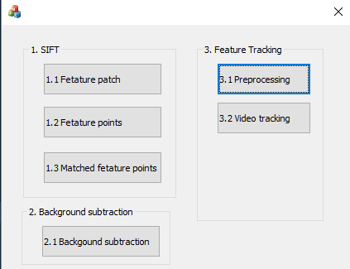
0. Homework Format
Use MFC to create GUI like following picture

Slide 6
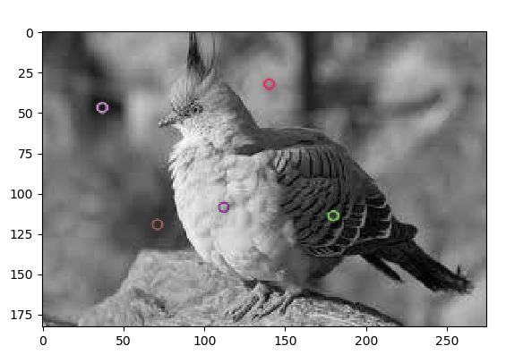
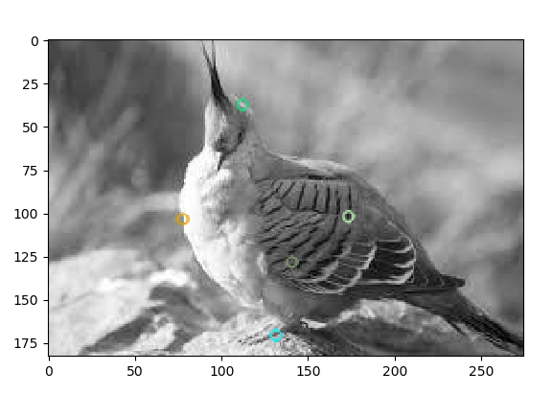
1. (40%) SIFT (出題：Tri, Carol, Ann, Helen, Phu)
Q: 1.1) (10%) Click button “1.2 Feature points” to show:
5 feature points on each image bird1.jpg and bird2.jpg
then save results as FeatureBird1.jpg and FeatureBird1.jpg as figure 2:
FeatureBird1.jpg
FeatureBird2.jpg
Figure 2. Feature points on two images.
Hint : (ref. : opencv2refman_2.4.7.pdf) ref. p663 ~ p670

Slide 7
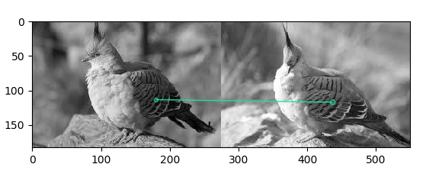
1. (40%) SIFT (出題：Tri, Carol, Ann, Helen, Phu)
Q: 1.2) (10%) Click button “1.3 Matched feature points”,
draw the matched feature points between two images from 5 keypoints pairs obtained in Q: 1.1) and show the results as Figure 3:
bird1.jpg
bird2.jpg
Figure 3. Feature points and their corresponding points.
Hint : (ref. : opencv2refman_2.4.7.pdf) ref. p663 ~ p670

Slide 8
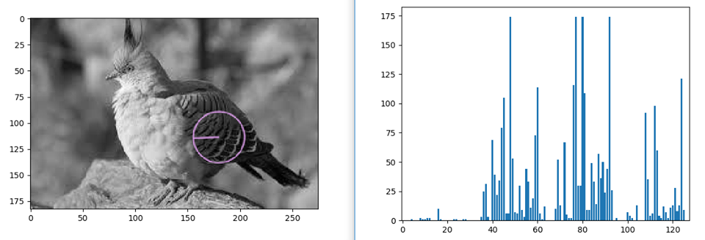
1. (40%) SIFT (出題：Tri, Carol, Ann, Helen, Phu)
Given: A pair of images, bird1.jpg and bird2.jpg.
Q: 1.3) (20%) Click button “1.1 Feature patch” to show:
one feature point at P(179.9, 114.0) in the image bird1.jpg
then show a 128-bin feature vector histogram of that feature point as figure 1.
P(179.9, 114.0)
127
bird1.jpg
featureVectorHistogram.jpg
Figure 1. Feature point and its histogram
Hint : (ref. : opencv2refman_2.4.7.pdf) ref. p663 ~ p670

Slide 9
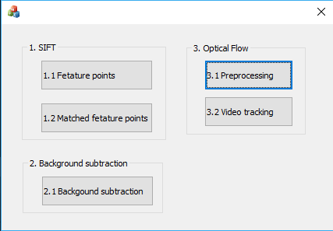
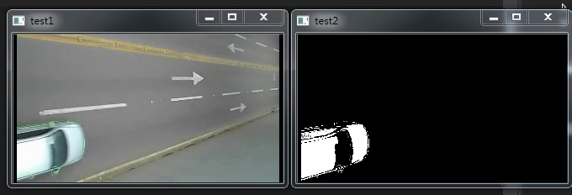
2. (20%) Background Subtraction (出題：Erin, Daniel)
Given a video: bgSub.mp4
Q: 1) (20%) Click the button “2.1 Background Subtraction” to open two windows:
One shows the original video, bgSub.mp4
The other is the foreground video.
Use first 50 frames to train the background model
You need to subtract background model to find the foreground object (white part)
Hint : textbook p372 ~ p376
Demo video:

Slide 10
3. (40%) Optical Flow (出題：Edward)
3.1 Preprocessing (20%)
3.2 Video tracking (20%)

Slide 11

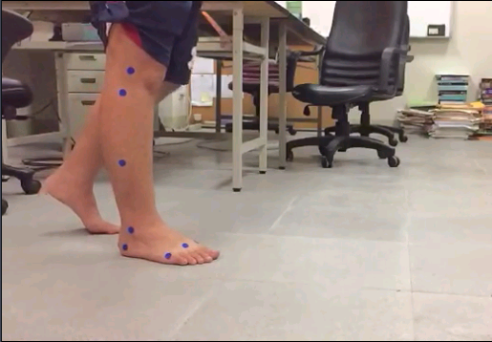
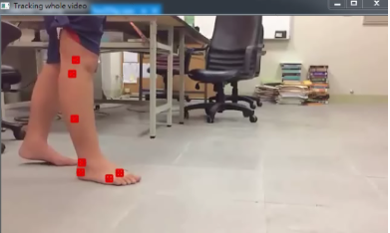
3.1 Preprocessing (20%) (出題：Edward)
Given a video: opticalFlow.mp4
Q: 1) Click the button “3.1 Preprocessing” to:
(10%) Manually (setMouseCallback ) or automatically (SimpleBlobDetector) detect 7 center points of 7 blue circles of the 1st frame.
(10%) Show the square boundary (not red filled like the ex. image).
window size: 10
7 blue circles
Center point
Ex:
(0,0)
x
y

Slide 12
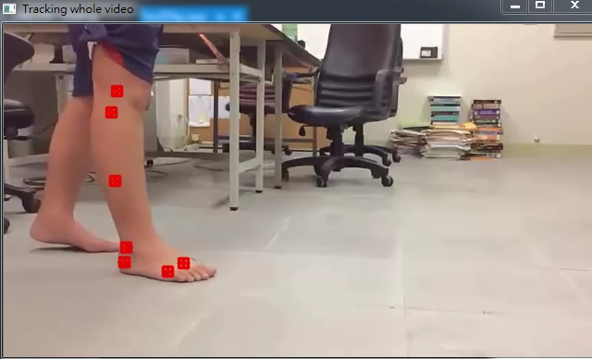
3.2 Video tracking (20%) (出題：Edward)
Q: 2) Click button “3.2 Video tracking” to
(10%) Track the 7 center points on the whole video using OpenCv function calcOpticalFlowPyrLK(args, winsize=21x21). Ex: https://github.com/opencv/opencv/blob/master/samples/cpp/lkdemo.cpp
(10%) Connect 7 corresponding tracking points of all frames (the whole video) to get 7 trajectories (flow). Ex: the demo video.
Hint: textbook Chapter 10 (p332 ~ p334)
Demo video:
※ Tracking process may be fail, you can adjust points' positions on some frames and then track again.

